Slide 1
Confidentiality Policies

Slide 2
Outline
Overview
  What is a confidentiality model
Bell-LaPadula Model
  General idea
  Description of rules
Tranquility
Controversy
  †-property
  System Z
IFETCE/M.E CSE/NE7202-NIS/Unit 1

Slide 3
Confidentiality Policy
Goal: prevent the unauthorized disclosure of information
  Deals with information flow
  Integrity incidental
Principle of “executive privilege”
Multi-level security models are best-known examples
  Bell-LaPadula Model basis for many, or most, of these

Slide 4
Military Security Policy
Basis of many OS security policies
Based on protecting classified information with respect to confidentiality.
each piece of information is ranked at a particular sensitivity level:
  unclassified
  restricted
  confidential
  secret
  top secret
IFETCE/M.E CSE/NE7202-NIS/Unit 1

Slide 5
Military Security Policy
each piece of information may be associated with one (or more) projects, called compartments.
The combination <rank; compartments> is called the classification or class of a piece of information.
a person has a clearance to access information up to a certain level of sensitivity.
The clearance of a person has the same form as the classification of a piece of information: <rank; compartments>
IFETCE/M.E CSE/NE7202-NIS/Unit 1

Slide 6
Military Security Policy
Limited by the Need-to-Know rule: Access is allowed only to subjects who need to know data to perform job.
the use of compartments helps to enforce the need-to-know rule.
the user may not alter classifications, i.e. the policy requires Mandatory Access Control (MAC).
IFETCE/M.E CSE/NE7202-NIS/Unit 1

Slide 7
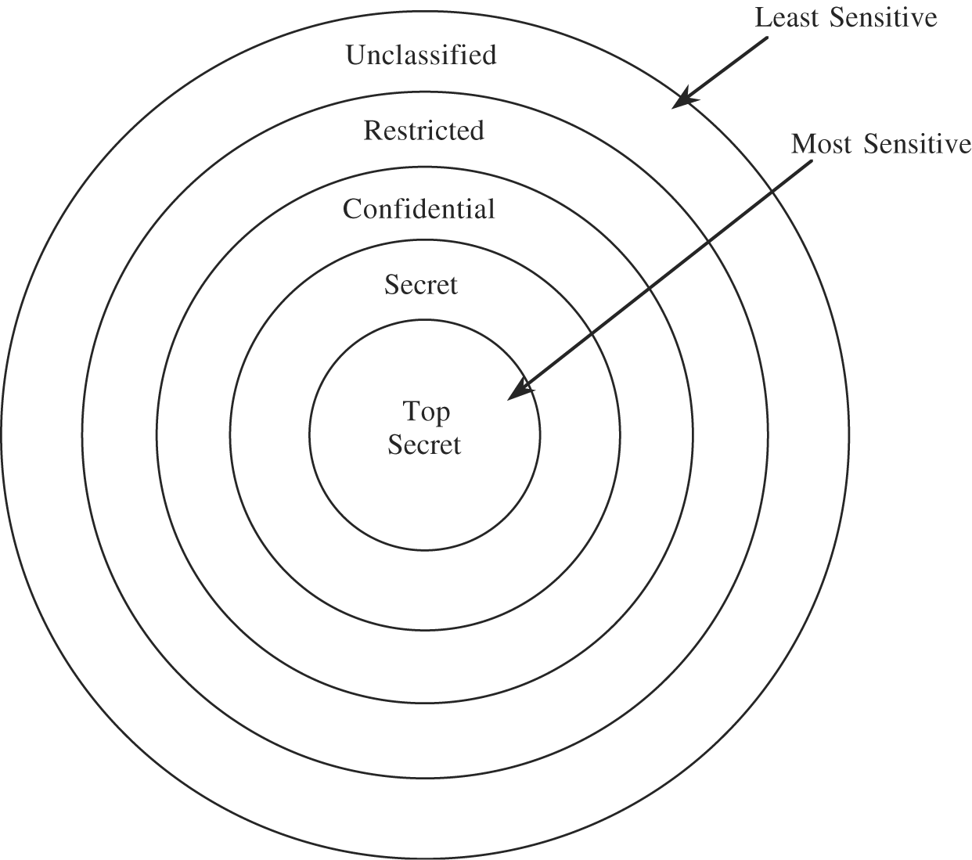
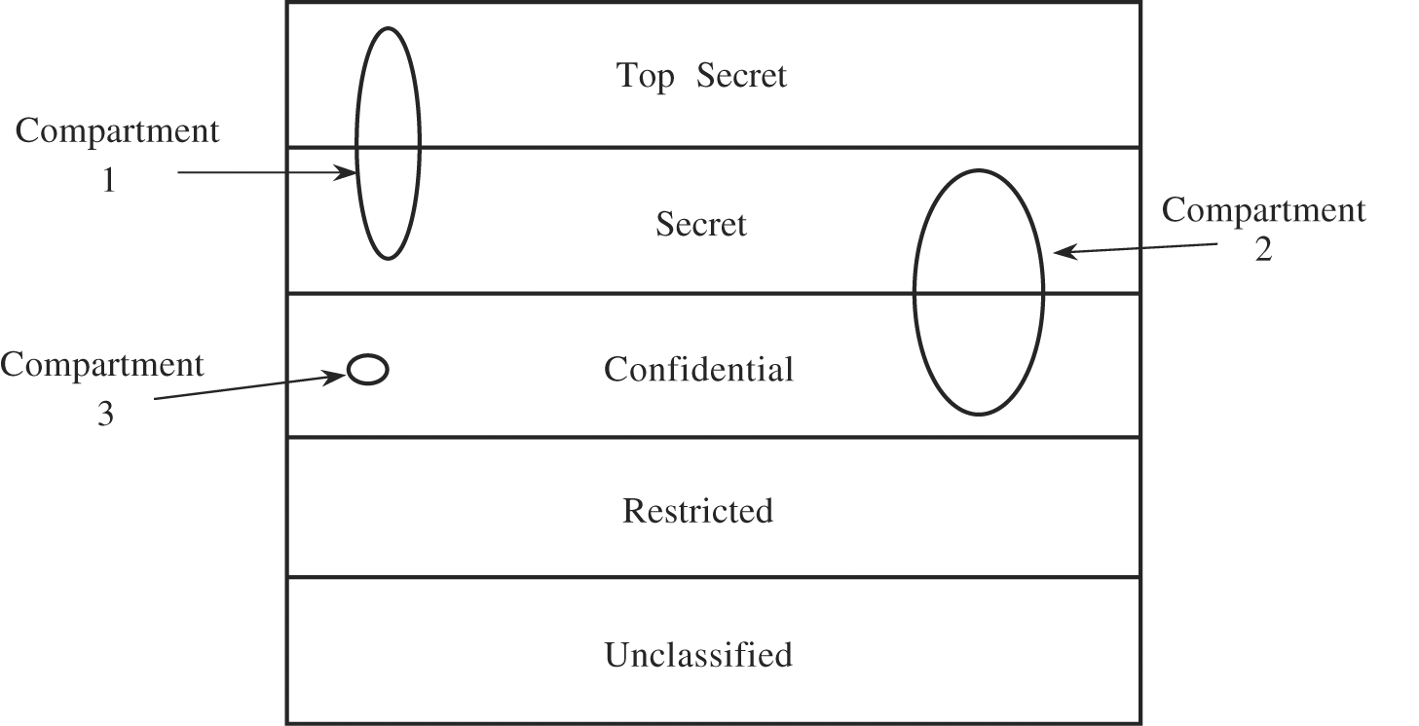
Military Security Policy
Hierarchy of Sensitivities
Compartments & Sensitivity Levels
IFETCE/M.E CSE/NE7202-NIS/Unit 1

Slide 8
Military Security Policy
Classification - <rank; compartments>
  This enforces need-to-know both by security level and by topic
Clearance – person is trusted to access information up to a given level of sensitivity with need-to-know
Dominance, on a set of Objects (o) and Subjects (s)
  s ≤ o if and only if
  rank(s) ≤ rank (0) and
  compartments (s) ⊆ compartments(0)
  We say o dominates s (or s is dominated by o)
  Dominance is used to limit the sensitivity and content of information a subject can access
A subject can read an object only if:
  clearance level of the subject is at least as high as the information
  Subject has a need-to-know about all compartments for which the information is classified
IFETCE/M.E CSE/NE7202-NIS/Unit 1

Slide 9
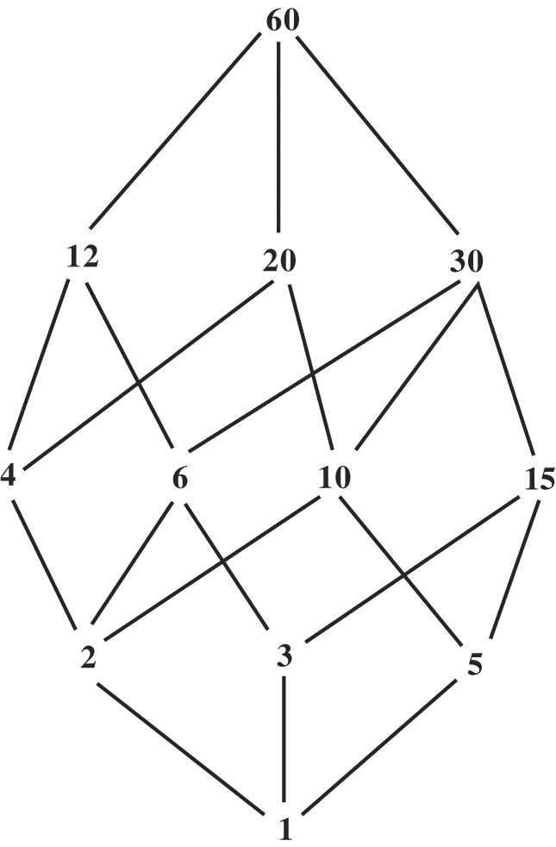
Multilevel Security
Build a model to represent a range of sensitivities and to reflect the need to separate subjects rigorously from objects to which they should not have access
The generalized model is called the Lattice Model of Security
IFETCE/M.E CSE/NE7202-NIS/Unit 1

Slide 10
Bell-La Padula Confidentiality Model
Formal description of allowable paths of flow in a secure system
Bell-LaPadula model was developed in 1973
Formalization of the military security policy
This model has two components:
  Classification
  Set of categories
IFETCE/M.E CSE/NE7202-NIS/Unit 1

Slide 11
Two Principles
To protect information confidentiality
  No-read-up, a subject is allowed a read access to an object only if the access class of the subject dominate the access class of the object
  No-write-down, a subject is allowed a write access to an object only if the access class of the subject is dominated by the access class of the object
IFETCE/M.E CSE/NE7202-NIS/Unit 1

Slide 12
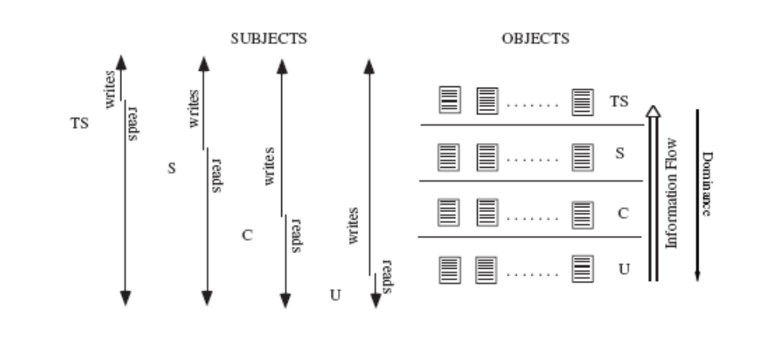
No-read-up & No-write-down
Can TS subject write to S object?
Can S subject write to U object?
IFETCE/M.E CSE/NE7202-NIS/Unit 1

Slide 13
Bell – LaPadula Model
Two main properties of this model for a secure system are:
  Simple security property
  Star property
Simple security means: A subject may have read or write access to an object only if the clearance of the subject dominates the security level of the object
IFETCE/M.E CSE/NE7202-NIS/Unit 1

Slide 14
Bell – LaPadula Model
Star property means: An untrusted subject may:
append if object security dominates subject security
write if object security equals subject security
read if object security is less than subject security
This model guarantees secrecy by preventing unauthorized release of information
This model does not protect from unauthorized modification of information
IFETCE/M.E CSE/NE7202-NIS/Unit 1

Slide 15
Two properties
Simple Security Property – A subject s may have read access to object o only if C(o) ≤ C(s)
*-Property – A subject s who has read access to an object o may have write access to an object p only if C(o) ≤ C(p)
C(s) – clearance; c(o) classification
Write-down – high level subjects transfers high level data to a low level object (prevented by star property)
IFETCE/M.E CSE/NE7202-NIS/Unit 1
Slide #5-<number>

Slide 16
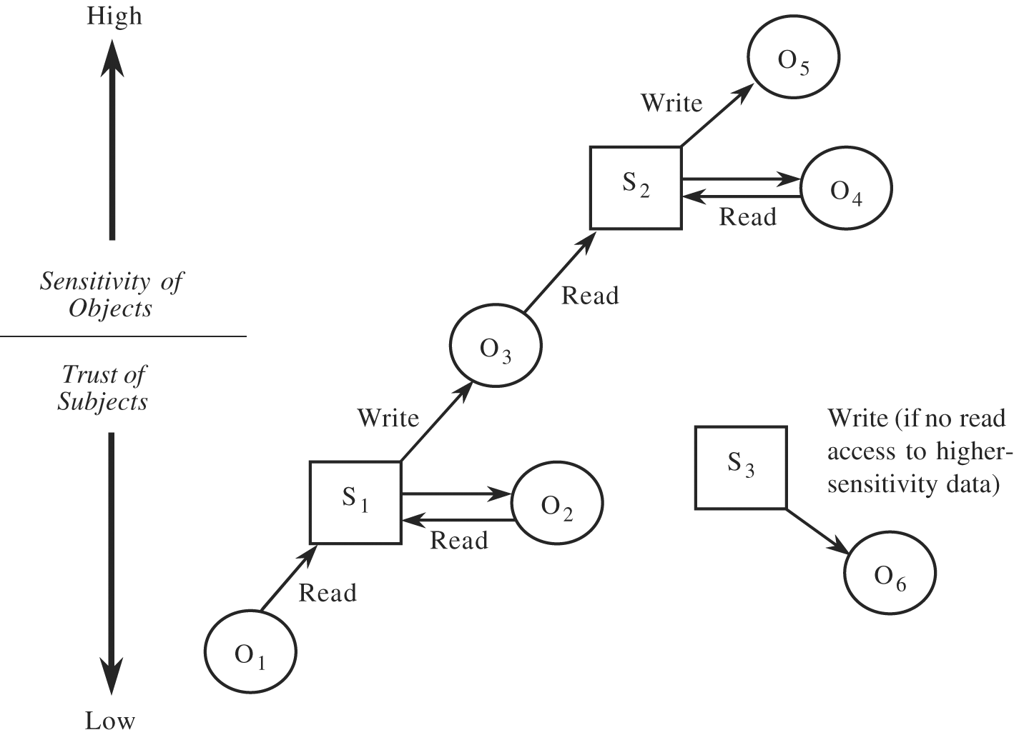
Secure Flow of Information
Two properties
IFETCE/M.E CSE/NE7202-NIS/Unit 1

Slide 17
Bell-LaPadula Model, Step 1
Security levels arranged in linear ordering
  Top Secret: highest
  Secret
  Confidential
  Unclassified: lowest
Subjects have security clearance L(s)
Objects have security classification L(o)
IFETCE/M.E CSE/NE7202-NIS/Unit 1

Slide 18
Example
security level | subject | object
Top Secret | Tamara | Personnel Files
Secret | Samuel | E-Mail Files
Confidential | Claire | Activity Logs
Unclassified | Ulaley | Telephone Lists
Tamara can read all files
Claire cannot read Personnel or E-Mail Files
Ulaley can only read Telephone Lists
IFETCE/M.E CSE/NE7202-NIS/Unit 1
Slide #5-<number>

Slide 19
Reading Information
Information flows up, not down
  “Reads up” disallowed, “reads down” allowed
Simple Security Condition (Step 1)
  Subject s can read object o iff, L(o) ≤ L(s) and s has permission to read o
    Note: combines mandatory control (relationship of security levels) and discretionary control (the required permission)
  Sometimes called “no reads up” rule
IFETCE/M.E CSE/NE7202-NIS/Unit 1

Slide 20
Writing Information
Information flows up, not down
  “Writes up” allowed, “writes down” disallowed
*-Property (Step 1)
  Subject s can write object o iff L(s) ≤ L(o) and s has permission to write o
    Note: combines mandatory control (relationship of security levels) and discretionary control (the required permission)
  Sometimes called “no writes down” rule
IFETCE/M.E CSE/NE7202-NIS/Unit 1

Slide 21
Basic Security Theorem, Step 1
If a system is initially in a secure state, and every transition of the system satisfies the simple security condition (step 1), and the *-property (step 1), then every state of the system is secure
  Proof: induction on the number of transitions
Meaning of “secure” in axiomatic
IFETCE/M.E CSE/NE7202-NIS/Unit 1

Slide 22
Need to Know
Consider the notion of “need-to-know”
Example:
  Two sections for a class, with two TAs
  TA1 doesn’t need to know grades for section 2, and vice versa
  Cannot introduce linear ordering between TAs to enforce this
Military applications:
  Different operations
  Someone cleared for Top Secret on operation X may not need to know even unclassified documents on operation Y
IFETCE/M.E CSE/NE7202-NIS/Unit 1

Slide 23
Bell-LaPadula, Step 2
Expand notion of security level to include categories (also called compartments)
Security level is (clearance, category set)
Examples
  ( Top Secret, { NUC, EUR, ASI } )
  ( Confidential, { EUR, ASI } )
  ( Secret, { NUC, ASI } )
IFETCE/M.E CSE/NE7202-NIS/Unit 1

Slide 24
Levels and Lattices
(A, C) dom (A′, C′) iff A′ ≤ A and C′ ⊆ C
Examples
  (Top Secret, {NUC, ASI}) dom (Secret, {NUC})
  (Secret, {NUC, EUR}) dom (Confidential,{NUC, EUR})
  (Top Secret, {NUC}) ¬dom (Confidential, {EUR})
  (Secret, {NUC}) ¬dom (Confidential,{NUC, EUR})
Let C be set of classifications, K set of categories. Set of security levels L = C × K, dom form lattice
  Partially ordered set
  Any pair of elements
    Has a greatest lower bound
    Has a least upper bound
IFETCE/M.E CSE/NE7202-NIS/Unit 1

Slide 25
Example Lattice
ASI,NUC,EUR
ASI,NUC
ASI,EUR
NUC,EUR
EUR
ASI
NUC
∅
IFETCE/M.E CSE/NE7202-NIS/Unit 1

Slide 26
Subset Lattice
TS: ASI,
NUC,EUR
TS:
NUC,EUR
C:
NUC,EUR
TS:
NUC,ASI
TS:NUC
S:NUC
C:EUR
U: ∅
IFETCE/M.E CSE/NE7202-NIS/Unit 1

Slide 27
Levels and Ordering
Security levels partially ordered
  Any pair of security levels may (or may not) be related by dom
“dominates” serves the role of “greater than” in step 1
  “greater than” is a total ordering, though
IFETCE/M.E CSE/NE7202-NIS/Unit 1

Slide 28
Reading Information
Information flows up, not down
  “Reads up” disallowed, “reads down” allowed
Simple Security Condition (Step 2)
  Subject s can read object o iff L(s) dom L(o) and s has permission to read o
    Note: combines mandatory control (relationship of security levels) and discretionary control (the required permission)
  Sometimes called “no reads up” rule
IFETCE/M.E CSE/NE7202-NIS/Unit 1

Slide 29
Writing Information
Information flows up, not down
  “Writes up” allowed, “writes down” disallowed
*-Property (Step 2)
  Subject s can write object o iff L(o) dom L(s) and s has permission to write o
    Note: combines mandatory control (relationship of security levels) and discretionary control (the required permission)
  Sometimes called “no writes down” rule
IFETCE/M.E CSE/NE7202-NIS/Unit 1

Slide 30
Basic Security Theorem, Step 2
If a system is initially in a secure state, and every transition of the system satisfies the simple security condition (step 2), and the *-property (step 2), then every state of the system is secure
  Proof: induct on the number of transitions
IFETCE/M.E CSE/NE7202-NIS/Unit 1

Slide 31
Problem
One-way flow of information may be too restrictive
E.g. Colonel with Top Secret clearance cannot write to anywhere a Major with Secret clearance can read
  Is this a problem?
IFETCE/M.E CSE/NE7202-NIS/Unit 1

Slide 32
Solution
Define maximum, current levels for subjects
  maxlevel(s) dom curlevel(s)
Example
  Treat Major as an object (Colonel is writing to him/her)
  Colonel has maxlevel (Secret, { NUC, EUR })
  Colonel sets curlevel to (Secret, { EUR })
  Now L(Major) dom curlevel(Colonel)
    Colonel can write to Major without violating “no writes down”
  Does L(s) mean curlevel(s) or maxlevel(s)?
    Formally, we need a more precise notation
IFETCE/M.E CSE/NE7202-NIS/Unit 1

Slide 33
Adjustments to “write up”
Write permission usually allows read/write access to object
  So both simple security condition and *-property apply
  S dom O and O dom S means S=O
BLP discuss append as a “pure” write so “write up” still applies
IFETCE/M.E CSE/NE7202-NIS/Unit 1

Slide 34
Principle of Tranquility
Raising object’s security level
  Information once available to some subjects is no longer available
  Usually assume information has already been accessed, so this does nothing
Lowering object’s security level
  The declassification problem
  Essentially, a “write down” violating *-property
  Solution: define set of trusted subjects that sanitize or remove sensitive information before security level lowered
IFETCE/M.E CSE/NE7202-NIS/Unit 1

Slide 35
Types of Tranquility
Strong Tranquility
  The clearances of subjects, and the classifications of objects, do not change during the lifetime of the system
Weak Tranquility
  The clearances of subjects, and the classifications of objects change in accordance with a specified policy.
IFETCE/M.E CSE/NE7202-NIS/Unit 1

Slide 36
Example
DG/UX System
  Only a trusted user (security administrator) can lower object’s security level
  In general, process MAC labels cannot change
    If a user wants a new MAC label, needs to initiate new process
    Cumbersome, so user can be designated as able to change process MAC label within a specified range
Other systems allow multiple labeled windows to address users operating a multiple levels
IFETCE/M.E CSE/NE7202-NIS/Unit 1

Slide 37
Controversy
McLean:
  “value of the BST is much overrated since there is a great deal more to security than it captures. Further, what is captured by the BST is so trivial that it is hard to imagine a realistic security model for which it does not hold.”
IFETCE/M.E CSE/NE7202-NIS/Unit 1

Slide 38
Definition of Security
BLP define security in terms of *-property
State (b, m, f, h) satisfies the *-property iff for each s ∈ S the following hold:
  b(s: a) ≠ ∅ ⇒ [∀o ∈ b(s: a) [ f_{c}(o) dom f_{o}(s) ] ]
  b(s: w) ≠ ∅ ⇒ [∀o ∈ b(s: w) [ f_{o}(o) = f_{c}(s) ] ]
  b(s: r) ≠ ∅ ⇒ [∀o ∈ b(s: r) [ f_{c}(s) dom f_{o}(o) ] ]
IFETCE/M.E CSE/NE7202-NIS/Unit 1

Slide 39
Redefinition: †-property
State (b, m, f, h) satisfies the †-property iff for each s ∈ S the following hold:
  b(s: a) ≠ ∅ ⇒ [∀o ∈ b(s: a) [ f_{c}(s) dom f_{o}(o) ] ]
  b(s: w) ≠ ∅ ⇒ [∀o ∈ b(s: w) [ f_{o}(o) = f_{c}(s) ] ]
  b(s: r) ≠ ∅ ⇒ [∀o ∈ b(s: r) [ f_{c}(s) dom f_{o}(o) ] ]
Idea: for writing, subject dominates object; for reading, subject also dominates object
Differs from *-property in that the mandatory condition for writing is reversed
  For *-property, it’s object dominates subject
IFETCE/M.E CSE/NE7202-NIS/Unit 1

Slide 40
Analogues
The following two theorems can be proved
Σ(R, D, W, z₀) satisfies the †-property relative to S′ ⊆ S for any secure state z₀ iff for every action (r, d, (b, m, f, h), (b′, m′, f′, h′)), W satisfies the following for every s ∈ S´
  Every (s, o, p) ∈ b – b′ satisfies the †-property relative to S′
  Every (s, o, p) ∈ b′ that does not satisfy the †-property relative to S′ is not in b
Σ(R, D, W, z₀) is a “secure” system if z₀ is a secure state and W satisfies the conditions for the simple security condition, the †-property, and the ds-property.
IFETCE/M.E CSE/NE7202-NIS/Unit 1

Slide 41
Problem
This system is clearly non-secure!
  Information flows from higher to lower because of the †-property
IFETCE/M.E CSE/NE7202-NIS/Unit 1

Slide 42
System Z
Only one transition rule
  Get-read(s,o), if s dom o allow read and set all objects to system low
This system meets BLP requirements for security given weak tranquility
  Given secure initial state, each subsequent state is secure
Points out the need to evaluate the transition rules
IFETCE/M.E CSE/NE7202-NIS/Unit 1

Slide 43
Discussion
Role of Basic Security Theorem is to demonstrate that rules preserve security
Key question: what is security?
  Bell-LaPadula defines it in terms of 3 properties (simple security condition, *-property, discretionary security property)
  Theorems are assertions about these properties
  Rules describe changes to a particular system instantiating the model
  Showing system is secure requires proving rules preserve these 3 properties
IFETCE/M.E CSE/NE7202-NIS/Unit 1

Slide 44
Key Points
Confidentiality models restrict flow of information
Bell-LaPadula models multilevel security
  Cornerstone of much work in computer security
  Simple security property says no read up and
  Star property says no write down
  Both ensure information can only flow up
Definition of security as important as model for enforcing it
IFETCE/M.E CSE/NE7202-NIS/Unit 1

